Slide 1
All Pairs Shortest Path
05 September 2025

Slide 2
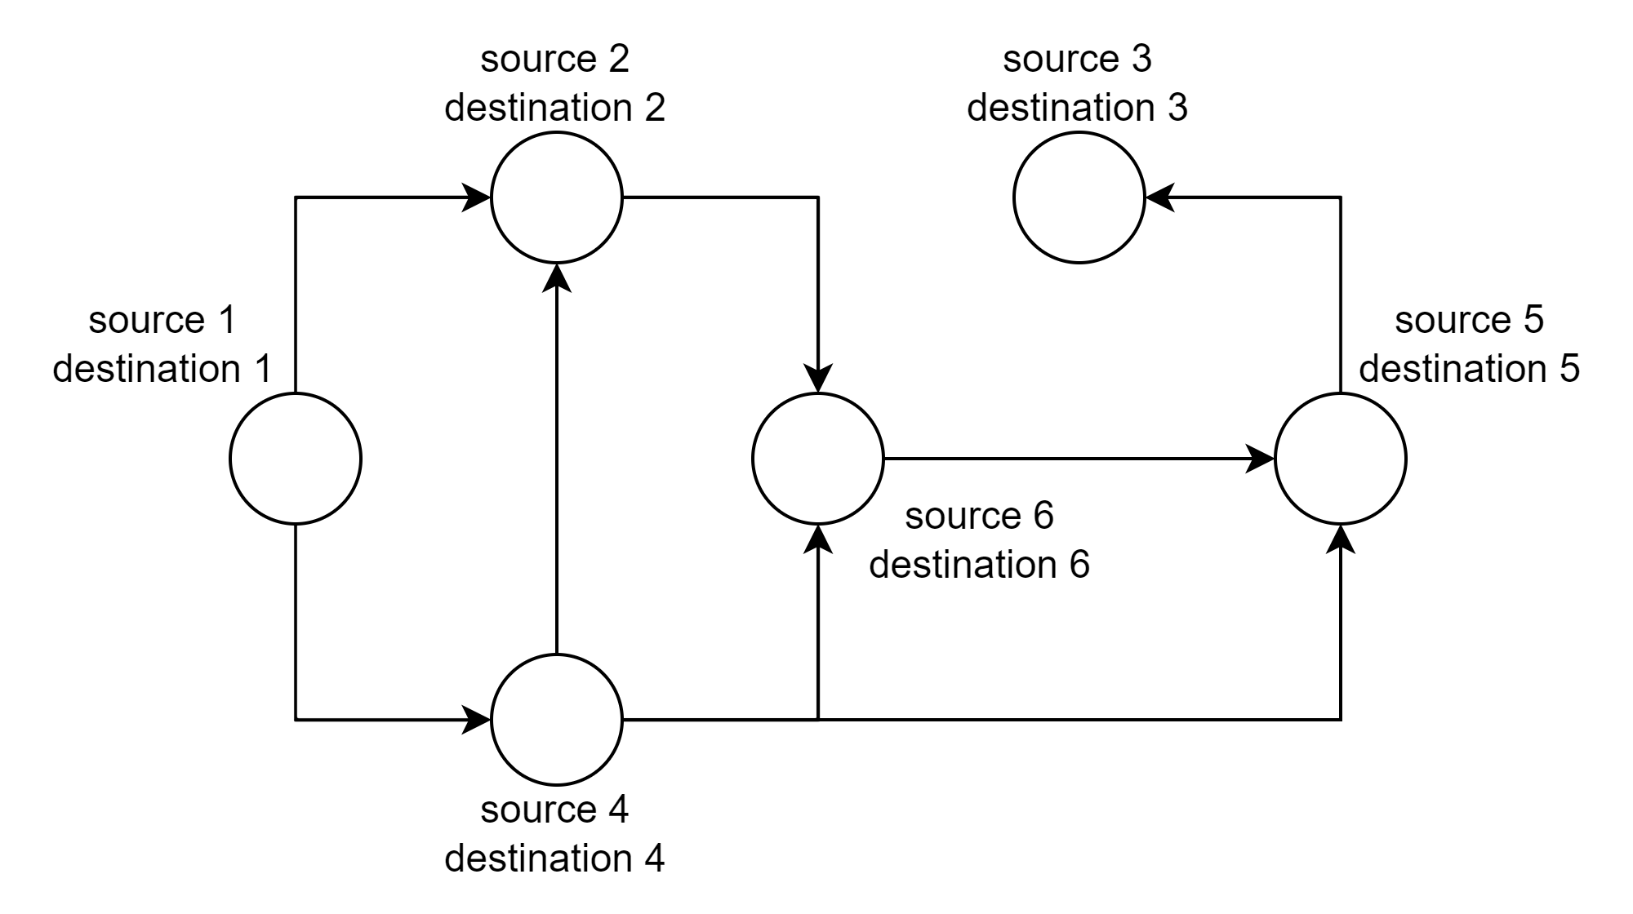
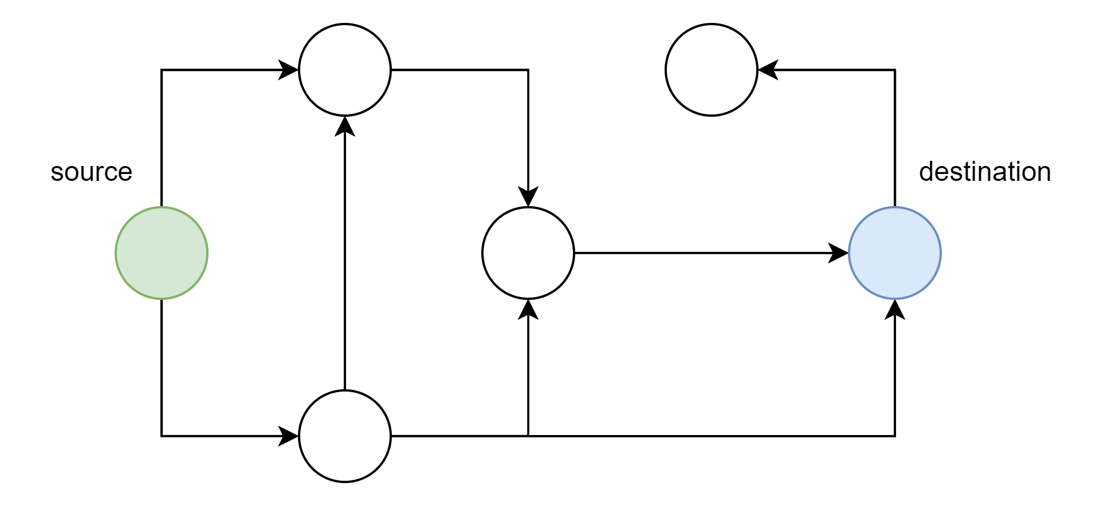
All Pairs Shortest Path – Problem Statement
Let's say we have a graph and we want to find two vertices between which the distance is the biggest.
Type 2: You have a graph G
Find S to D with the min or max distance
Type 1: You have S and D
Find the min or max distance: S to D
Today’s topic

Slide 3
Big Code, but Fast Approach
For every node: run Dijkstra algorithm and find nodes with the minimum or maximum distance.
dist = [], src = [], dst = [];
for cur_src in graph:
cur_dst, distance = Dijkstra(cur_src, graph);
src.append(cur_src); dst.append(cur_dst);
dist.append(distance);
index = max_element_as_index(dist)
print(“The longest distance is between: ‘{src[index]}’ and ‘{dst[index]}’.”);
V calls of Dijkstra O((V + E) * log(V)) => O(V³ * log(V), if E = O(V³)
Dijkstra is needed to be implemented anyway

Slide 4
Floyd-Warshall Algorithm
Let's assume weights provided as an adjacency matrix - AM.
for k in range(V):
for i in range(V):
for j in range(V):
AM[i][j] = min(AM[i][j], AM[i][k] + AM[k][j]);
The algorithm is significantly shorter!

Slide 5
Compare Algorithms
Condition | Best Choice | Why
V <= 450 | Floyd-Warshall | Faster to implement
V > 450, graph sparse | Dijkstra called V times | O(V² log V) vs O(V³)
V > 450, graph dense | Floyd-Warshall | O(V³) vs O(V³), but code is smaller
For Dijkstra if graph is dense – E = O(V²):
V * O((E + V) * log(V)) = V * O(V² * log(V)) = O(V³ log(V)) = O(V³)
For Dijkstra if graph is sparse – E = O(V):
V * O((E + V) * log(V)) = V * O(V * log(V)) = O(V² * log(V))

Slide 6

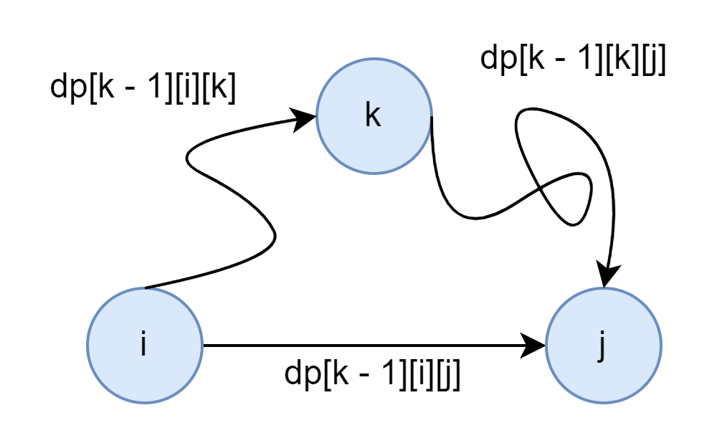
Floyd-Warshall Algorithm – Why it Works
for k in range(V):
for i in range(V):
for j in range(V):
DP[i][j] = min(DP[i][j], DP[i][k] + DP[k][j]);
Algorithm has a dynamic programming (DP) nature.
Visualization of
DP[k][i][j] = min(DP[k - 1][i][j], DP[k - 1] [i][k] + DP[k - 1][k][j])
is on the left picture

Slide 7
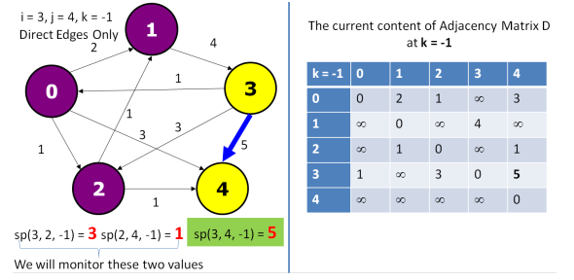
Floyd-Warshall Algorithm – Visualization
Visualization from the book Competitive Programming 4.

Slide 8
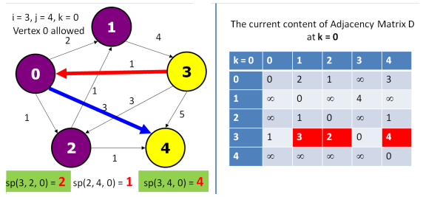
Floyd-Warshall Algorithm – Visualization
Visualization from the book Competitive Programming 4.

Slide 9
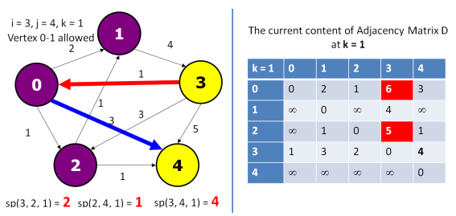
Floyd-Warshall Algorithm – Visualization
Visualization from the book Competitive Programming 4.

Slide 10
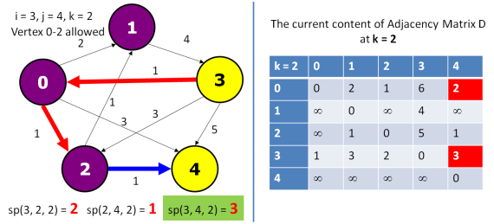
Floyd-Warshall Algorithm – Visualization
Visualization from the book Competitive Programming 4.

Slide 11
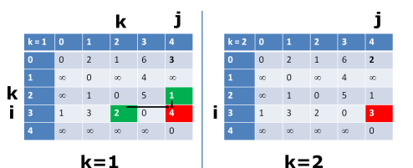
Floyd-Warshall Algorithm – DP Visualization
Visualization from the book Competitive Programming 4.

Slide 12
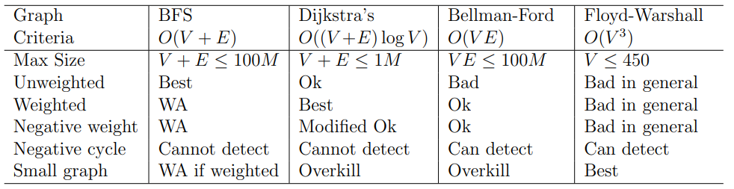
Shortest Path Algorithm Decision

Slide 13
Shortest Path Algorithm Decision - Quiz
Quiz: What is difference between graph with negative weights and graph with negative cycles?

Slide 14
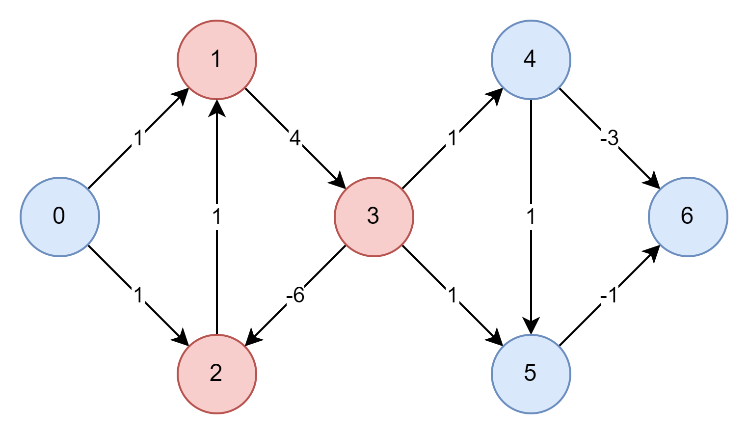
Negative Cycles and Weights
Examples from the graph presented above:
Edge from 4 to 6 – is negative wight – it is not affecting distance to nodes.
Loop 1 – 3 – 2 can be cause if negative infinity distance from 0 to 5 in case of some of the algorithms which are not able to detect negative cycles, for example, Dijkstra.

Slide 15

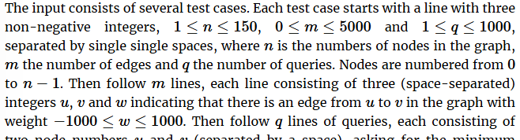
All Pairs Shortest Path
Kattis: All Pairs Shortest Path

